Slide 1
Algorithm and Software Development for the Next Generation of Large-scale Geographic Information Systems: Future and Challenges
新一代大规模地理信息系统的算法与软件设计、未来与挑战
陈梓楠（深圳大学特聘教授）

Slide 2
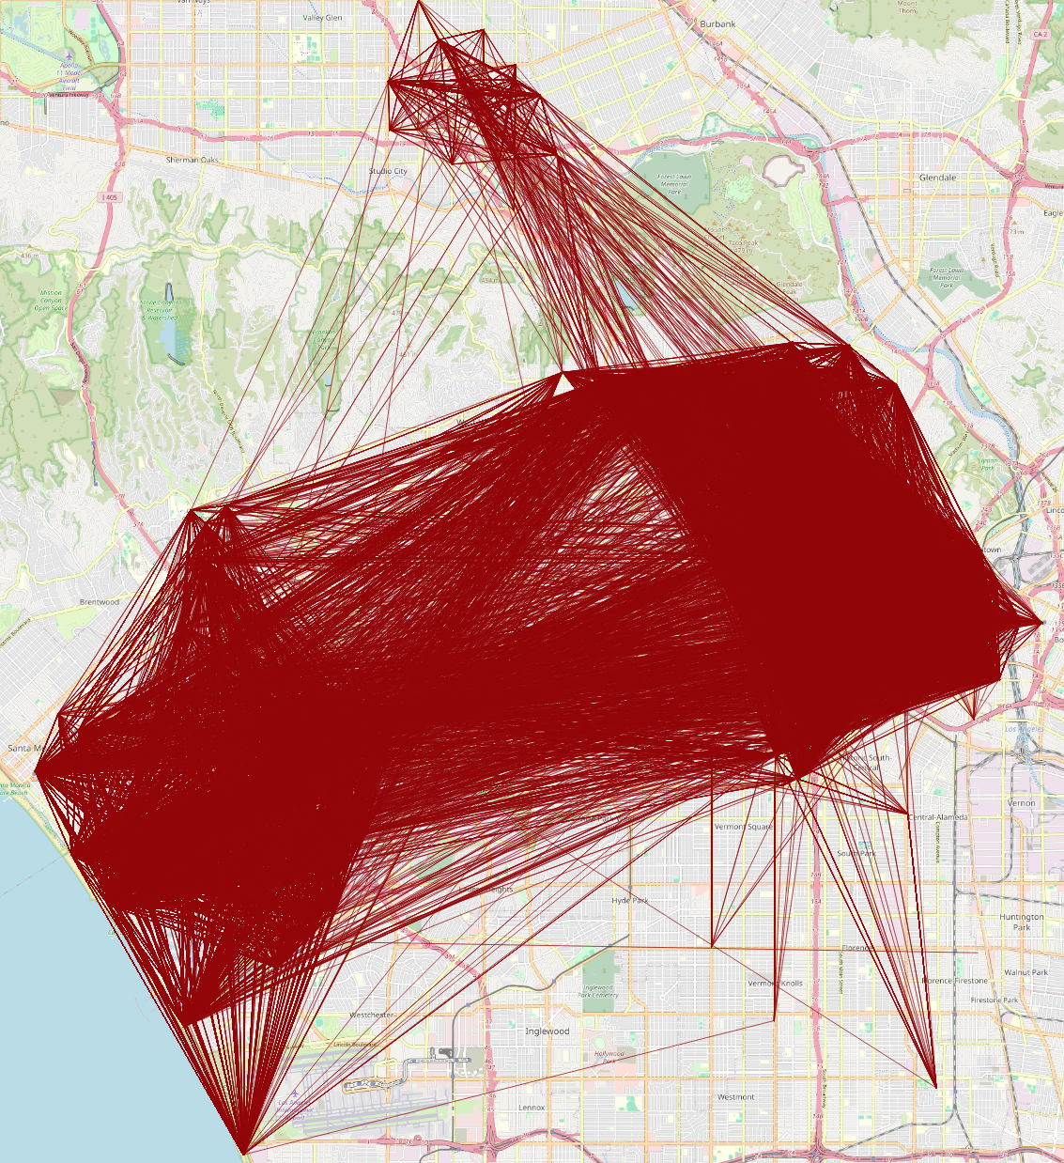
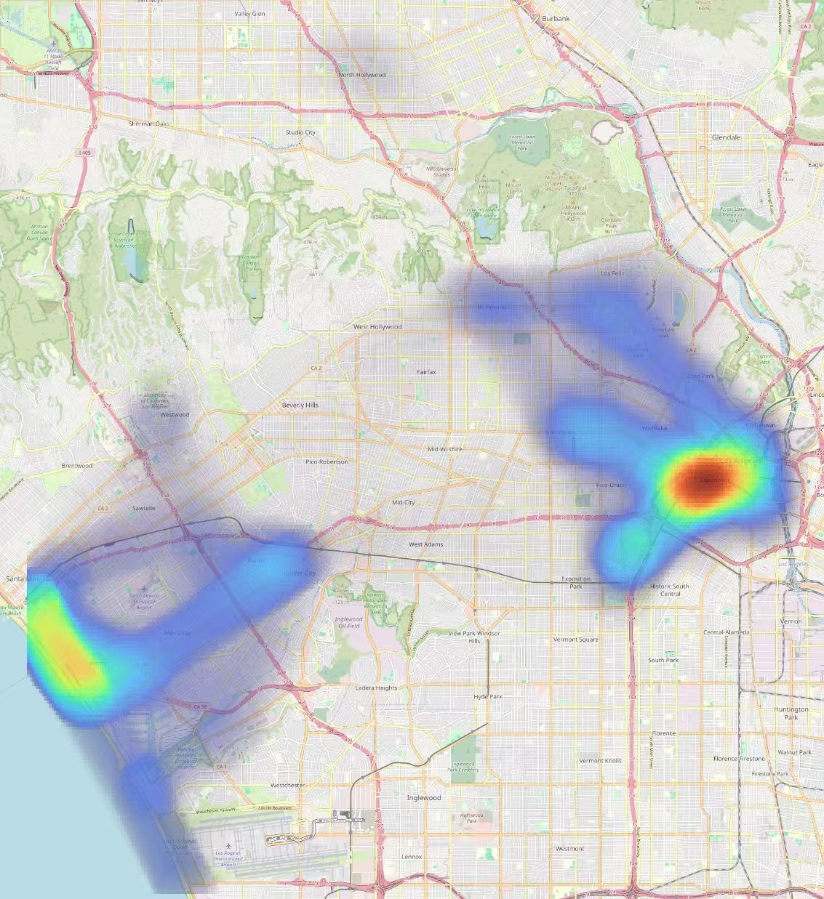
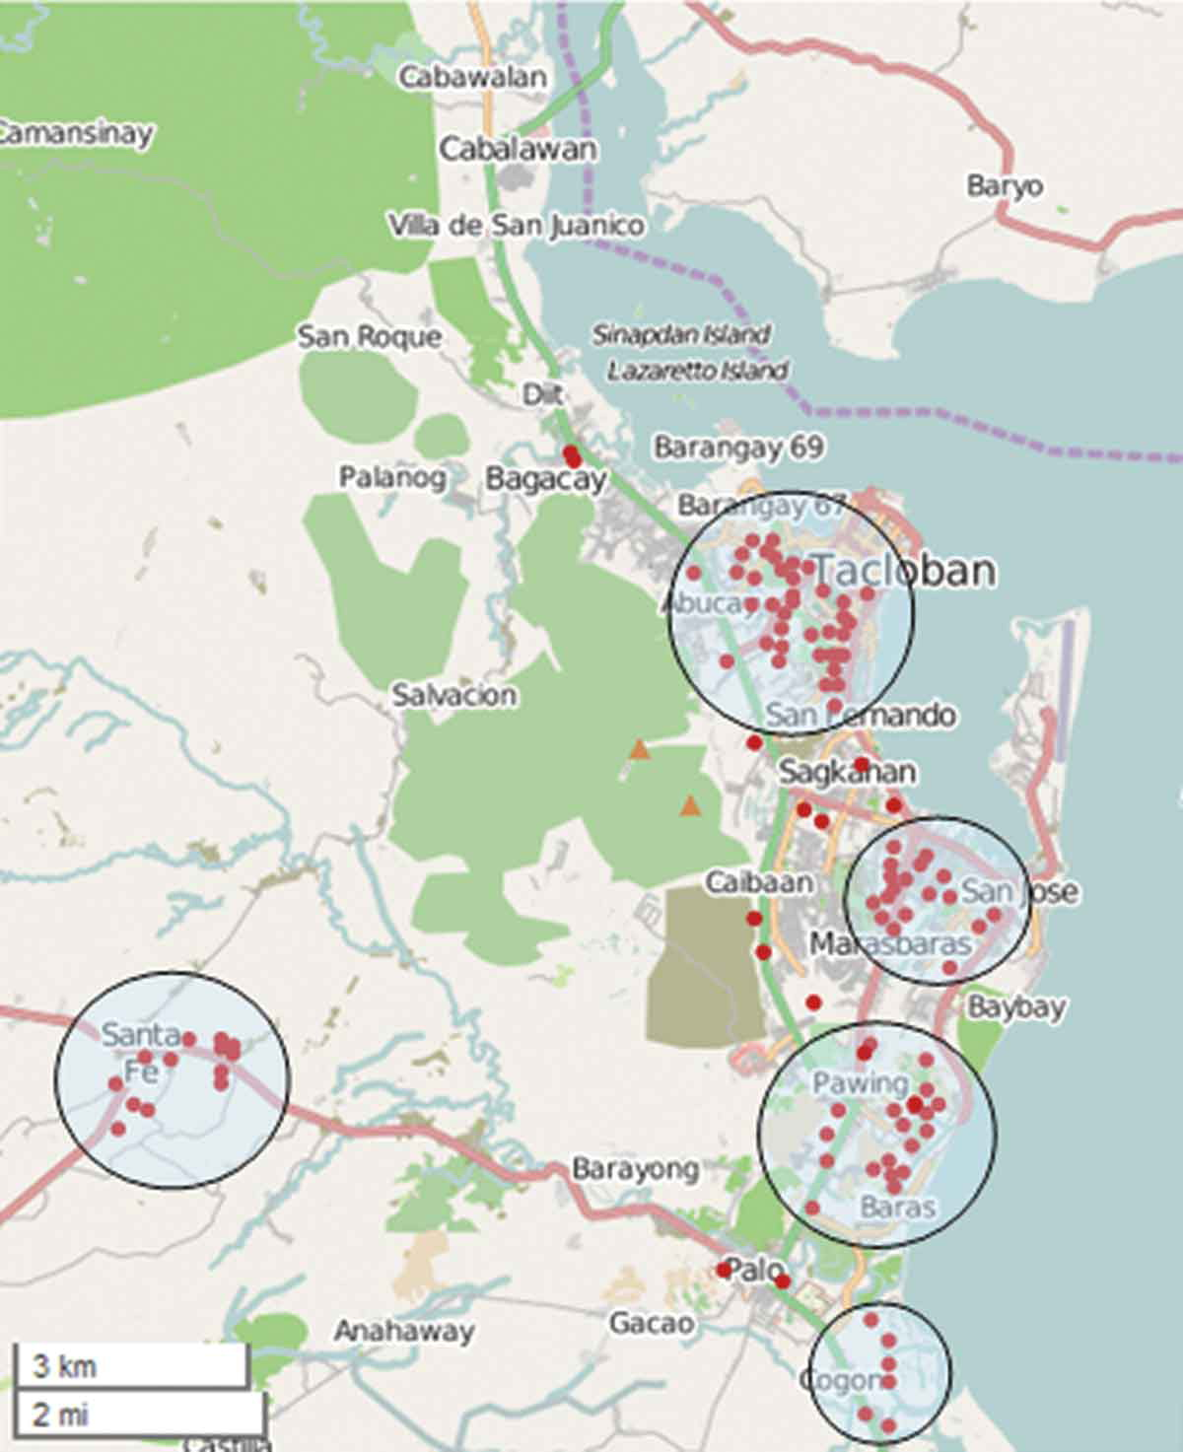
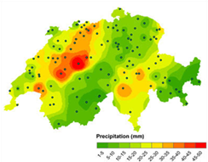
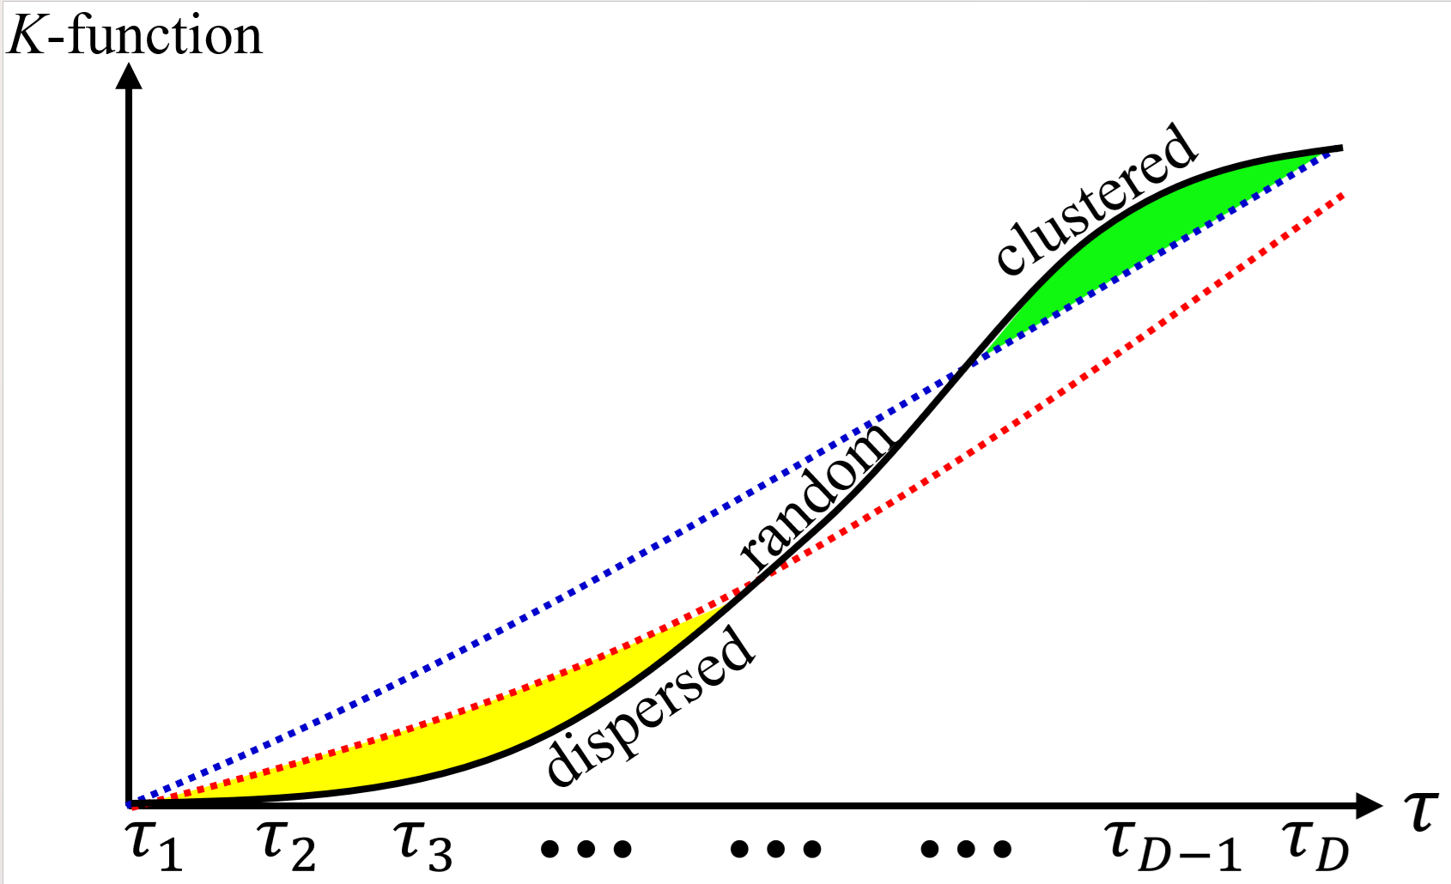
What Can GIS Do?
Point density visualization
Line/flow density visualization
$$p_{3}$$
$$τ$$
$$τ$$
$$τ$$
$$τ$$
$$p_{2}$$
$$p_{3}$$
$$p_{2}$$
$$p_{4}$$
$$p_{1}$$
$$p_{4}$$
$$p_{1}$$
$$τ$$
$$τ$$
$$τ$$
$$τ$$
Dispersed
Clustered
Spatial interpolation
K-function-based Analysis
Point clustering

Slide 3
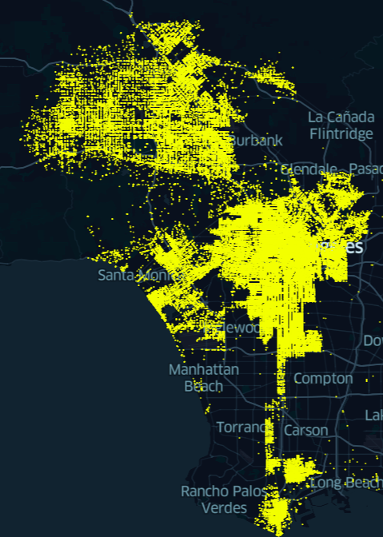
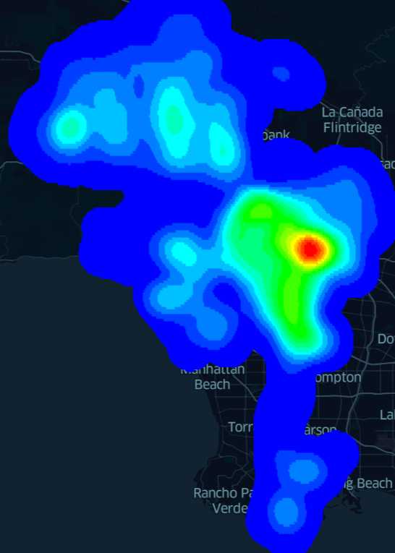
GIS Software Packages are Slow!
Many spatial analysis tools take at least quadratic time complexities.
Consider Kernel Density Visualization (KDV) as an example.
Resolution $X×Y=1280×960$
Number of data points $n=1000000$
Time cost is $XYn=1.228$ trillion ☹
Crime events in Los Angeles
KDV

Slide 4
Why are GIS Software Packages Slow?
Many large-scale location datasets are available.
Lack of research studies for reducing the time complexity of spatial analysis tools.
Many research studies only focus on parallel/distributed settings.
Users may not have too many computational resources.
Users may not have the right to access many computational resources.
Users only use some contemporary GIS software packages, e.g., ArcGIS and QGIS.

Slide 5
Our Preliminary Studies
Successfully reduce the time complexities for different spatial analysis tools.
Kernel density visualization and its variants
K-function analysis and its variants
Line density visualization
Can improve the efficiency for these tools with more than 10x to 2000x speedups under a single CPU setting.

Slide 6
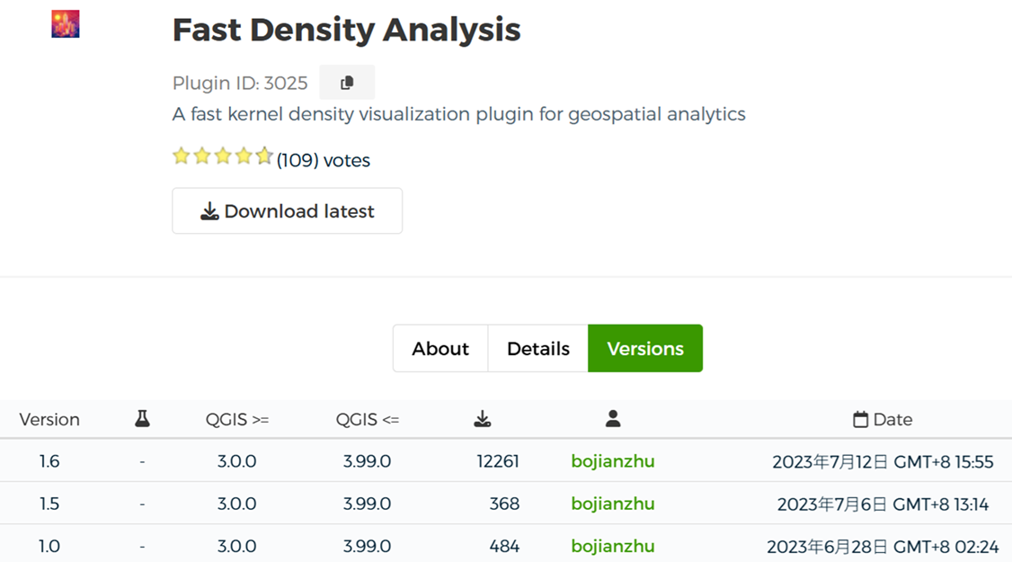
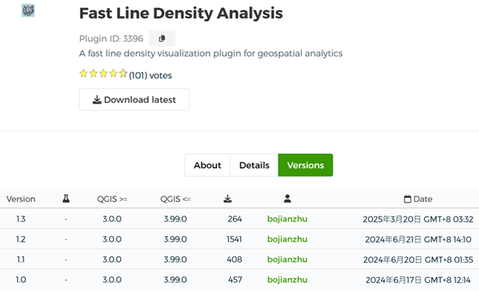
Our Preliminary Studies
Develop two QGIS plugins (based on our efficient algorithms)
13,113
2,670

Slide 7
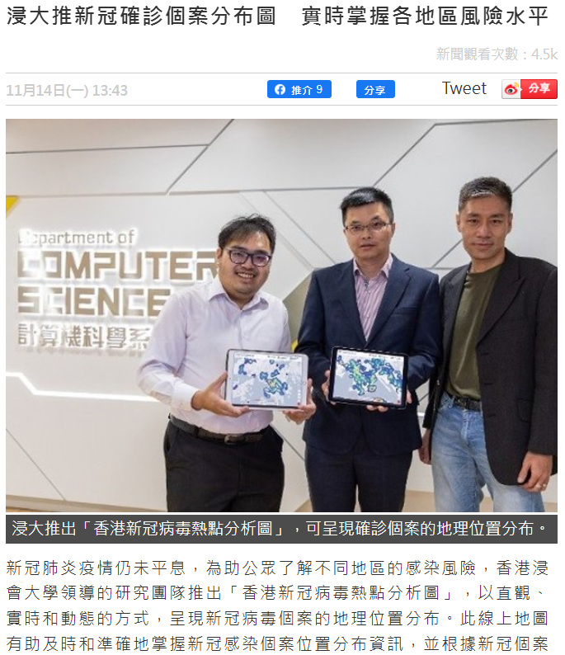
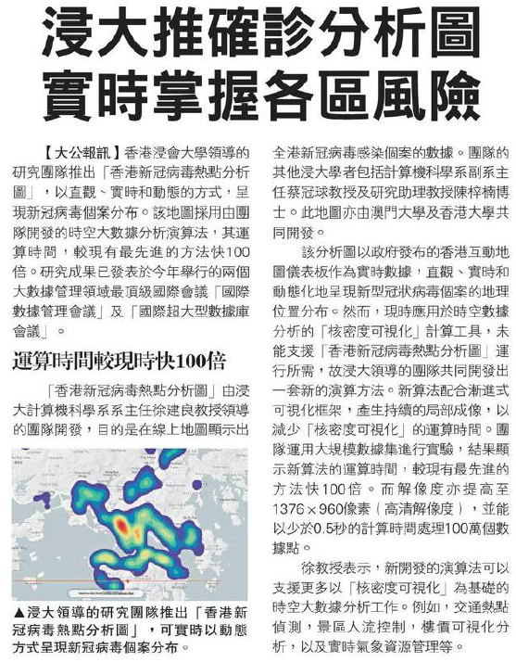
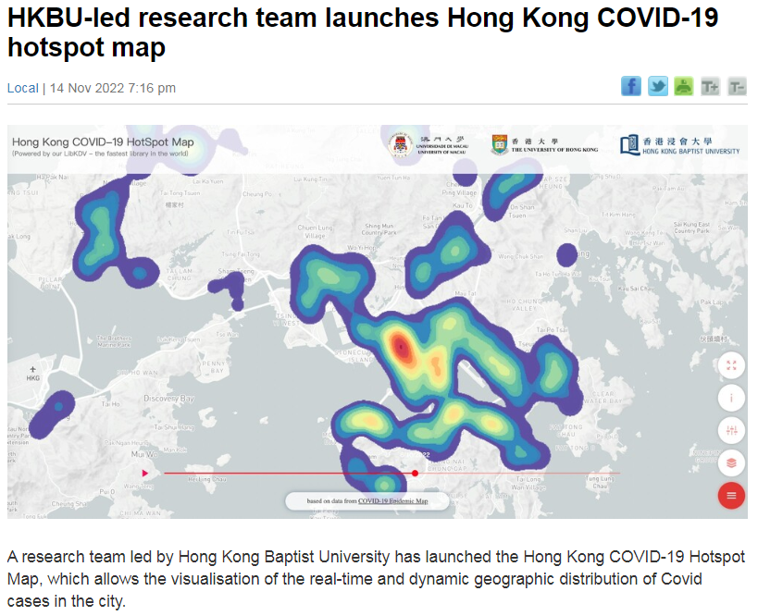
Our Preliminary Studies
Hong Kong and Macau COVID-19 Hotspot Maps
Hong Kong version (https://covid19.comp.hkbu.edu.hk/)
Macau version (http://degroup.cis.um.edu.mo/covid-19/)
Oriental Daily Hong Kong (in Chinese)
The standard
Ta Kung Pao News (in Chinese)

Slide 8
Future Directions
Develop complexity-reduced solutions to support other spatial analysis tools.
Inverse distance weighting (IDW)
Kriging
DBSCAN clustering
Moran’s I
Getis-Ord General G
Replace those inefficient (obsolete) algorithms in the GIS software packages by efficient algorithms. (leading to the next generation of GIS ☺)
Incorporate the parallel/distributed/hardware-based approach into efficient algorithms.

Slide 9
Challenges
Many spatial analysis tools and their variants are available.
It may be hard to find complexity-reduced solutions for some spatial analysis tools.
It may be difficult to combine the parallel/distributed/hardware-based approach with some efficient solutions.

