Slide 1
LION: Fast and High-Resolution Network Kernel Density Visualization
(Edison) Tsz Nam Chan¹, Rui Zang², Bojian Zhu²,
Leong Hou U³, Dingming Wu¹, Jianliang Xu²
¹Shenzhen University ²Hong Kong Baptist University ³University of Macau

Slide 2
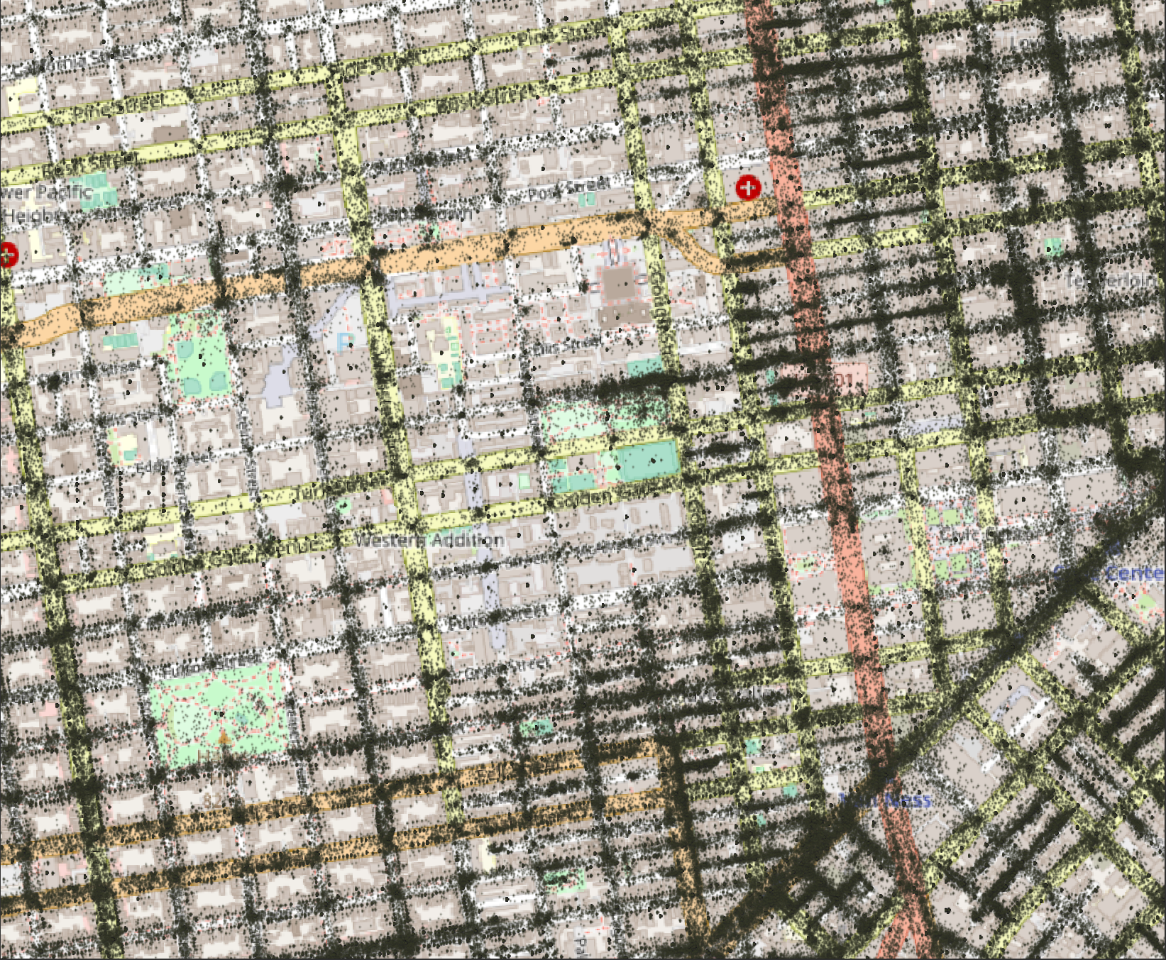
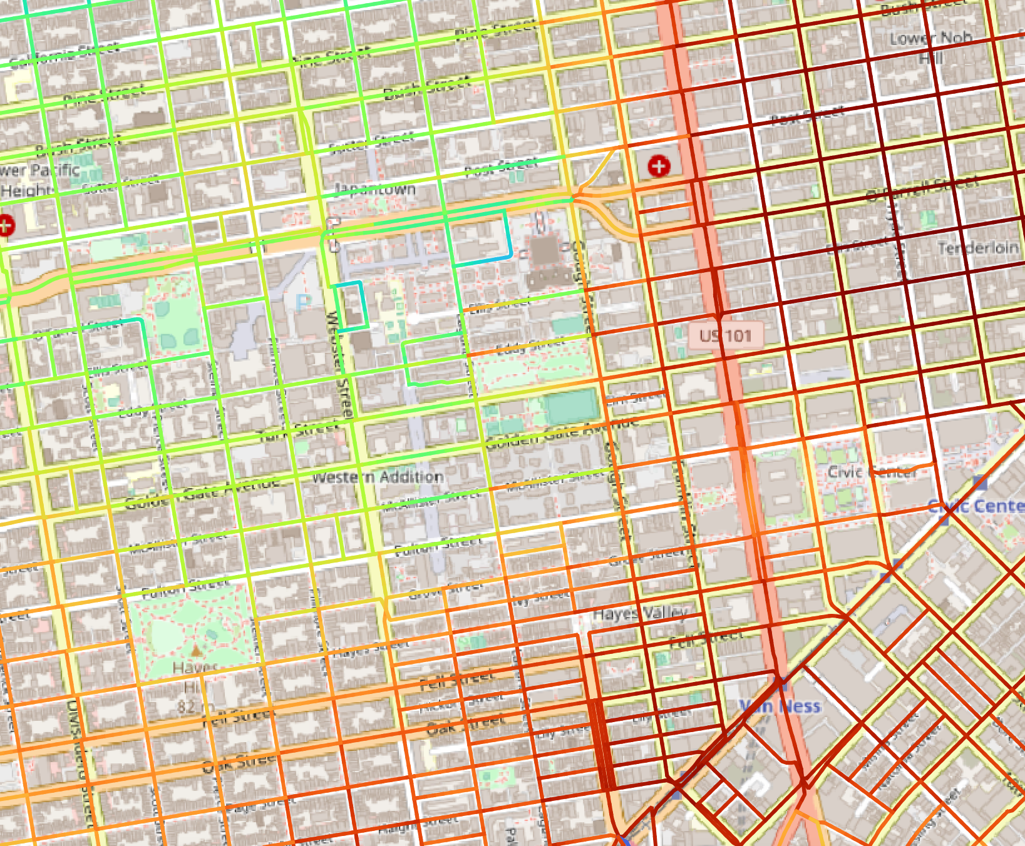
Overview of Network Kernel Density Visualization (NKDV)
A commonly used tool for visualizing hotspots in road networks.
Crime hotspot detection
Traffic accident hotspot detection
Traffic hotspot detection
311-call location data points in San Francisco
NKDV

Slide 3
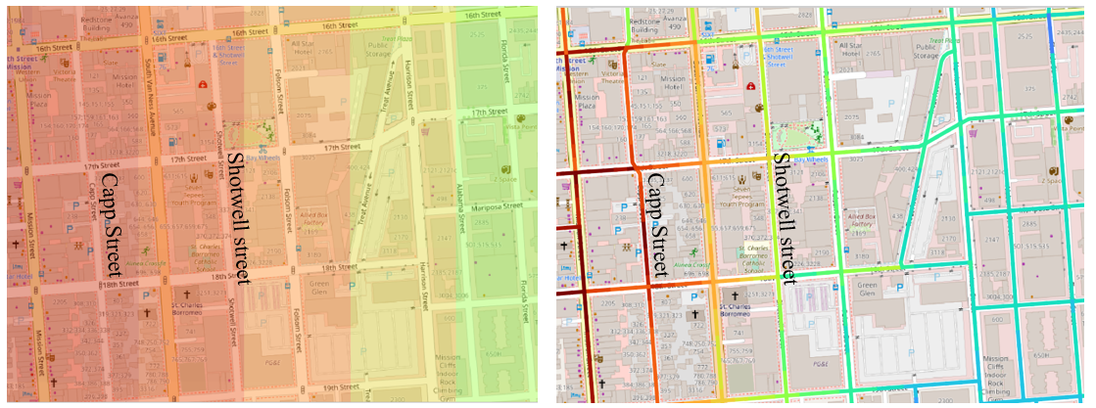
Why NKDV?
Why road networks? (Why “N”?)
KDV
NKDV
KDV and NKDV for the Mission District in San Francisco (using the 311-call dataset).

Slide 4
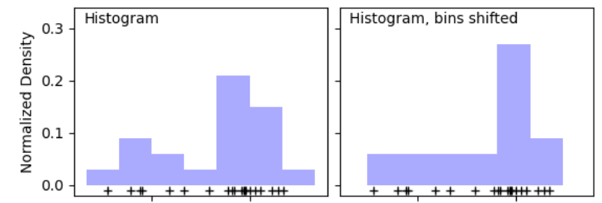
Why NKDV?
Why “kernel density”? (Why “KD”?)
More robust compared with other non-parametric methods (e.g., histogram).

Slide 5
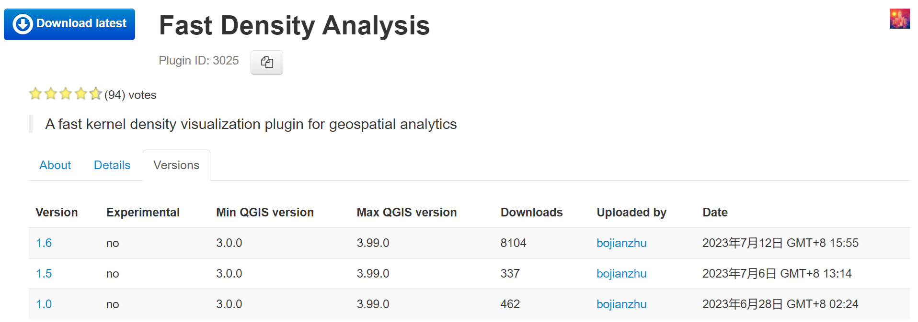
Why NKDV?
Why importance?
Supported by many famous software packages.
Used by many GIS experts.
8903

Slide 6
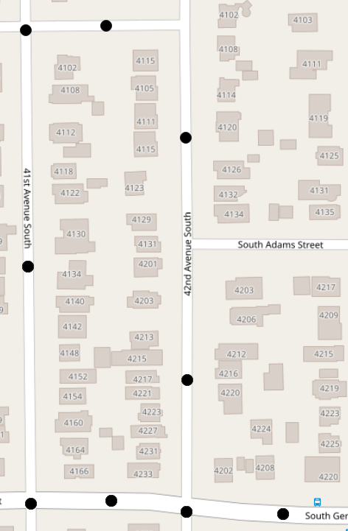
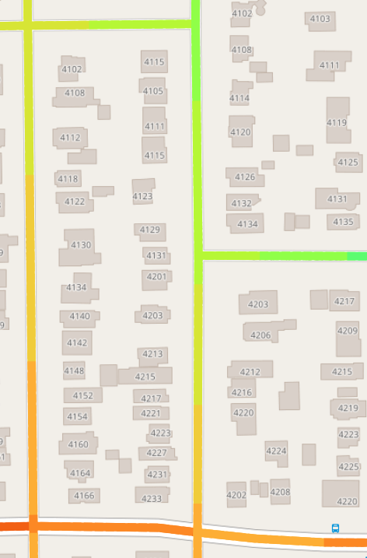
What is NKDV?
Consider a set of location data points $P$ in a road network $G=(V, E)$, which consists of a set of $L$ lixels.
Color each lixel $q$ based on the network kernel density function $ℱ_{P}\left(q\right)$.
lixel
weighting
shortest path distance
$$q$$
$$ℓ$$
$$ℱ_{P}\left(q\right)=\sum_{p_{i}∈P}{w}∙\left\{\begin{matrix}1−\frac{1}{b^{2}}{d_{G}(q,p_{i})}^{2} \\ 0\end{matrix}\right.$$
if $d_{G}(q,p_{i})≤b$
otherwise
dataset
bandwidth

Slide 7
NKDV is Slow!
High time complexity ☹
$\left|E\right|$ is the number of edges.
$T_{SP}$ is the time complexity of the shortest path algorithm.
$n$ is the number of data points.
$L$ is the number of lixels.
Complained by many domain experts ☹
$$O(\left|E\right|T_{SP}+nL)$$
Rakshit et al. [a] “Kernel smoothing of point events, which is simple to define and very fast to compute in two dimensions (Diggle 1985), is mathematically complicated and can be extremely time-consuming to perform on a network...”
[a] S. Rakshit, A. Baddeley, and G. Nair. Efficient code for second order analysis of events on a linear network. Journal of Statistical Software, Articles, 90(1):1–37, 2019.

Slide 8
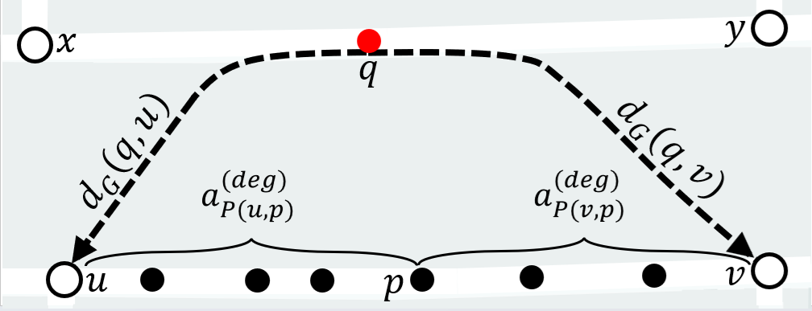
Existing Solution: Aggregate Distance Augmentation (ADA)
$$ℱ_{P(e)}\left(q\right)=\sum_{p_{i}∈P(e)}{w}∙\left\{\begin{matrix}1−\frac{1}{b^{2}}{d_{G}(q,p_{i})}^{2} \\ 0\end{matrix}\right.$$
$$ℱ_{P}\left(q\right)=\sum_{p_{i}∈P}{ℱ_{P(e)}\left(q\right)}$$
if $d_{G}(q,p_{i})≤b$
where
otherwise
Augment $a_{P(u,p)}^{(deg)}$ and $a_{P(v,p)}^{(deg)}$ in each data point $p$ of the edge $e=(u,v)$.
Use the binary search method to compute $ℱ_{P(e)}\left(q\right)$.
The time complexity of ADA is $O\left(\left|E\right|T_{SP}+L|E|\log\left(\frac{n}{|E|}\right)\right)≪O(\left|E\right|T_{SP}+nL)$.
$$a_{P(u,p)}^{(deg)}=\sum_{p_{i}∈P(u,p)}{{d_{G}(u,p_{i})}^{deg}}$$
$$a_{P(v,p)}^{(deg)}=\sum_{p_{i}∈P(v,p)}{{d_{G}(v,p_{i})}^{deg}}$$
[b] Tsz Nam Chan, Zhe Li, Leong Hou U, Jianliang Xu, Reynold Cheng: “Fast Augmentation Algorithms for Network Kernel Density Visualization” PVLDB 2021 (vol 14), pages 1503-1516.

Slide 9
Weakness of ADA
The number of lixels can be larger than the number of data points in practice ($L>n$).
Consider the London traffic accident dataset [c] and the London road network.
The number of lixels $L$ is 2.95 million (with the 5m lixel size).
The number of data points $n$ is only 0.838 million.
Domain experts can perform exploratory operations (e.g., filtering), making $L>n$.
$O\left(\left|E\right|T_{SP}+L|E|\log\left(\frac{n}{|E|}\right)\right)$ can still be slow!
One vehicle
Two vehicles
Three vehicles
[c] Road Safety Data. https://data.gov.uk/dataset/cb7ae6f0-4be6-4935-9277-47e5ce24a11f/road-safety-data.

Slide 10
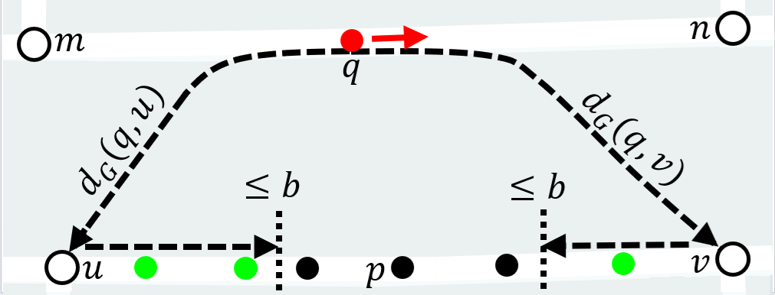
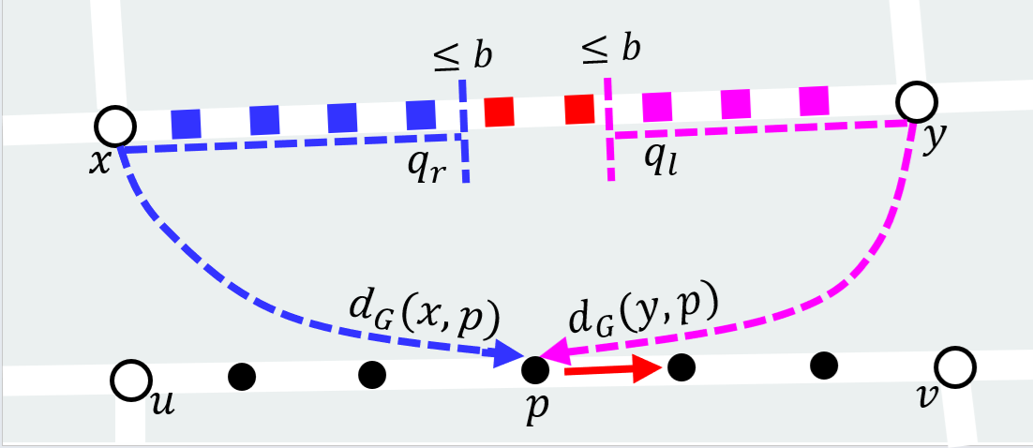
Core Idea of Our Solution: LION
Change from lixel-scanning to point-scanning.
Lixel-scanning
Point-scanning
$O\left(\left|E\right|T_{SP}+L|E|\log\left(\frac{n}{|E|}\right)\right)$
$O\left(\left|E\right|T_{SP}+n\left|E\right|+{|E|}^{2}+L\right)$
Lixel augmentation (refer to our paper)
Lixel aggregation (refer to our paper)

Slide 11
Experimental Evaluation

Slide 12
Conclusion
LION achieves lower time complexity compared with ADA, when $L>n$.
LION achieves 2.86x to 35.36x speedup compared with ADA.

Slide 13
Future Work
Can we develop some data sampling algorithms for generating approximate NKDV with non-trivial accuracy guarantees? (Ongoing)
Can we develop complexity-reduced algorithms for generating NKDV with the case $\left|E\right|>n$? (i.e., large road networks) (Ongoing)
Can we incorporate the parallel/distributed/hardware-based approach into LION to further boost its efficiency for generating NKDV? (Ongoing)
Can we further develop complexity-reduced algorithms to support NKDV with Gaussian kernel? (Ongoing)

Slide 14
Future Work
Can we further develop complexity-reduced algorithms to support network-temporal kernel density visualization (NTKDV)? (Done)
Can we develop complexity-reduced algorithms to support other types of GIS operations in road networks? (Ongoing)

